Slide 1
CSA0836-Python programming for web application MINI PROJECT – JAN 2024
TITLE:GESTURE DECTION SYSTEM USING MACHINE LEARNING ALOGRITHM
TEAM MEMEBERS:
SWATHY.S – 192219008
RUDHRESH.G.K-192219010
SAMSURENDAR.D - 192221013
MAHALAKSHMI.K.S - 192210181

Slide 2


INTRODUCTION:
Gesture detection is a fascinating and increasingly important field in computer vision, enabling computers to interpret human gestures and interactions.
In this context, Python provides a powerful and versatile platform for
developing gesture detection applications.
Whether you are working on a project related to human-computer interaction, virtual reality, or robotics.

Slide 3
ABSTRACT:
Gesture detection using machine learning has emerged as a prominent and dynamic area of research and application, offering a transformative way for computers to interpret human gestures and interactions.
The objective is to enable computers to understand and respond to hand movements, facial expressions, or other body gestures,
These estimations provide valuable information for refining the gesture recognition process,
The methodology involves capturing and processing image or video data using
computer vision libraries, such as OpenCV, to extract meaningful features from
gestures.

Slide 4
PRIMARY OBJECTIVE:
Human-Computer Interaction (HCI): Enabling users to interact with computers or devices using hand gestures, replacing traditional input methods like keyboards or touch screens.
Virtual and Augmented Reality (VR/AR): Tracking hand movements to interact with virtual objects or manipulate augmented reality environments in immersive experiences.
Robotics: Enabling robots to understand human gestures, facilitating natural communication and collaboration between humans and machines.
Sign Language Recognition: Translating sign language gestures into text or speech, aiding communication for individuals with hearing impairments.
Gaming: Integrating hand gestures as input controls for gaming applications, providing more immersive and intuitive game play experiences.

Slide 5
SECONDARY OBJECTIVE:
User Feedback and Interaction: Systems may aim to provide feedback or interact with users based on detected gestures.
Recognition of Complex Gestures: Apart from basic gestures like swiping or tapping, systems may aim to recognize more complex or nuanced gestures.
Real-time Performance and Efficiency: Finally, secondary objectives encompass optimizing gesture detection algorithms for real-time performance and efficiency.
Gesture Tracking and Temporal Analysis: Tracking hand movements over time and analyzing the temporal aspect of gestures are secondary objectives.
Adaptability and Robustness: This involves developing algorithms that can handle variations in hand appearance, environmental conditions, and user characteristics, ensuring reliable performance across diverse scenarios.

Slide 6
ADVANTAGES:
Gesture-based controls provide a more natural and intuitive way for users to interact with computers and devices, resembling real-world movements.
Enables hands-free control, allowing users to interact with devices without the need for physical touch or traditional input devices like keyboards or mice.
Gesture recognition enhances user engagement by creating interactive and immersive experiences, particularly in applications such as gaming and virtual reality.
Improves accessibility for individuals with physical disabilities, providing an alternative and more accessible means of interacting with technology.
Allows for efficient and quick navigation through interfaces and applications, especially in scenarios where rapid input is required.

Slide 7
DISADVANTAGES:
Gesture recognition systems may struggle with achieving fine-grained precision, especially when distinguishing between subtle or complex gestures.
Gesture recognition systems may struggle with achieving fine-grained precision, especially when distinguishing between subtle or complex gestures.
The range of recognizable gestures may be limited, which can restrict the diversity of commands or interactions that can be performed through gestures. Certain gestures may have different meanings in different cultural contexts or may be misinterpreted, leading to ambiguity in communication.
Gesture recognition systems, particularly those involving cameras, raise privacy concerns as they capture and process visual data, potentially infringing on individuals privacy.
Gesture-based interfaces heavily rely on technological components such as cameras and sensors. Malfunctions or technical issues can disrupt the user experience.

Slide 8
LITERATURE SURVEY
A literature survey on gesture detection systems delves into research methodologies, advancements, and applications within the field.
It starts with an introduction highlighting the significance of gesture detection systems in human-computer interaction (HCI) and their wide-ranging applications across diverse domains.
Traditional approaches like template matching, motion analysis, and rule-based systems are reviewed in detail.
Machine learning methods, including supervised, unsupervised, and reinforcement learning techniques, are explored for their efficacy in gesture recognition.
Deep learning techniques such as convolutional neural networks (CNNs) and recurrent neural networks (RNNs) are scrutinized for their ability to capture spatial and temporal information in gestures.

Slide 9
EXISTING WORK
Traditional approaches like template matching and motion analysis.
Modern machine learning methods including Support Vector Machines (SVM).
Deep learning techniques such as Convolutional Neural Networks (CNNs) and Recurrent Neural Networks (RNNs).
Utilization of various sensor technologies like cameras, depth sensors , accelerometers, and gyroscopes.
Availability of datasets such as Cha Learn LAP and N-UCLA for training and evaluation.
Challenges including occlusion, variability in gestures, real-time processing, and adaptation to diverse users.
Future directions focusing on multimodal fusion, context-aware recognition, and integration with augmented reality and virtual reality.

Slide 10
PROPOSED SYSTEM
The system aims to revolutionize HCI using advanced sensor technologies and machine learning algorithms.
Components include sensors, data acquisition, preprocessing, and gesture recognition modules.
Sensors like cameras and accelerometers are positioned strategically for accurate gesture capture.
Preprocessing removes noise and extracts relevant features from the captured data.
A sophisticated gesture recognition algorithm, often based on machine learning or deep learning, interprets gestures.
Recognized gestures are represented and mapped to specific commands or actions.
Integration into applications like gaming, virtual reality, and healthcare is seamless.

Slide 11
HARDWARE AND SOFTWARE REQUIRED
Hardware:
Sensors: RGB cameras, depth cameras (e.g., Microsoft Kinect, Intel RealSense), IMUs ( Accelerometers, gyroscopes, magnetometers), flex sensors or bend sensors.
Processing Unit: CPU or GPU, microcontrollers or embedded systems.
Storage: Hard disk or solid-state drive.
Display and Feedback Mechanism: Monitor or display screen, speakers or
haptic feedback
devices.
Power Supply: Power source or battery.
Software:
Operating System: Windows, Linux, or real-time operating systems (RTOS).
Programming Languages: Python, C/C++, MATLAB.
Development Tools: IDEs, version control systems like Git.
Data Visualization and Analysis: matplotlib, seaborn, Tableau, NumPy, pandas.
Gesture Recognition Software: OpenCV, TensorFlow, PyTorch, scikit-learn.
Documentation and Reporting: LaTeX, Markdown, Microsoft PowerPoint, LaTeX Beamer.
Deployment and Integration: Software deployment tools, APIs or SDKs.

Slide 12
CODING AND INTPUT SCREENSHOT
import cv2
import numpy as np
from sklearn.cluster import KMeans
def extract_hand_features(image):
gray = cv2.cvtColor(image, cv2.COLOR_BGR2GRAY)
contours, _ = cv2.findContours(gray, cv2.RETR_EXTERNAL, cv2.CHAIN_APPROX_SIMPLE)
import cv2
import numpy as np
from sklearn.cluster import KMeans
def extract_hand_features(image):
gray = cv2.cvtColor(image, cv2.COLOR_BGR2GRAY)
contours, _ = cv2.findContours(gray, cv2.RETR_EXTERNAL, cv2.CHAIN_APPROX_SIMPLE)
return features
def classify_gesture(features):
model = load_model
gesture = model.predict(features)
return gesture
def main():
cap = cv2.VideoCapture(0)
while True:
ret, frame = cap.read()
if not ret:
break
hand_features = extract_hand_features(frame)
gesture = classify_gesture(hand_features)
cv2.putText(frame, "Gesture: {}".format(gesture), (10, 30),
cv2.FONT_HERSHEY_SIMPLEX, 0.7, (0, 255, 0), 2)
cv2.imshow("Gesture Detection", frame)

Slide 13

FUNCTIONAL REQUIREMENTS:
Input: Define what kind of input will be used for gesture detection. It could be a live video stream from a webcam, pre-recorded video files, or even images.
2. Gesture Types: Specify the types of gestures you want to detect. This could include simple gestures like hand waves or more complex gestures like finger counting.
3. Detection Algorithm: Choose an appropriate algorithm or model for gesture detection based on the complexity of the gestures. For simple gestures, handcrafted feature-based methods may suffice, while for more complex gestures, deep learning models might be necessary.
4. Preprocessing: Define any preprocessing steps needed for the input data, such as resizing, normalization, or noise reduction.
5. Gesture Recognition: Define how the detected gestures will be recognized and interpreted. This could involve mapping detected patterns to specific gestures and determining the action associated with each gesture.
6. Accuracy and Performance: Define the criteria for evaluating the accuracy and performance of the gesture detection system. This could include metrics like detection accuracy, processing speed, and robustness to variations in lighting conditions or background clutter.

Slide 14
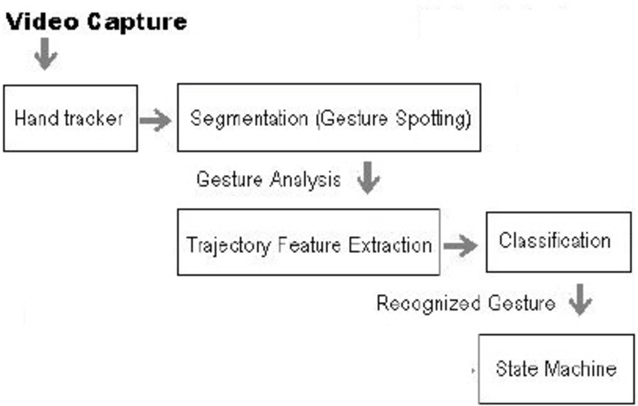

ARCHITECTURE:

Slide 15
TEST CASES AND RESULT:
Basic Gesture Detection: - Verify that the system can accurately detect basic gestures like hand waves, thumbs-up, or peace signs.
2. Complex Gesture Detection: - Test the system's ability to recognize more complex gestures such as finger counting, hand shapes (e.g., "OK" sign), or directional gestures (e.g., pointing).
3. Variations in Lighting: - Assess the system's robustness to changes in lighting conditions, including variations in brightness, shadows, and color temperature.
4. Background Clutter: - Test the system's performance in environments with different levels of background clutter, such as busy backgrounds or cluttered surfaces.
5. Hand Orientation and Position: - Evaluate how well the system handles variations in hand orientation, position, and distance from the camera.
6. Gesture Speed: - Test the system's ability to detect gestures accurately at different speeds, including slow, medium, and fast movements.
7. Gesture Duration: - Verify that the system can accurately detect gestures of varying durations, from quick gestures to more prolonged movements.

Slide 16

SECURITY AND CONTROL :
Data Encryption: Ensure that all data transmitted between the gesture detection system and any associated devices or servers is encrypted using strong encryption protocols. This prevents unauthorized access to the data in transit.
Authentication and Authorization: Implement robust authentication mechanisms to ensure that only authorized users can access the system. Use techniques like biometric authentication, passwords, or multi-factor authentication to verify the identity of users. Additionally, enforce strict access controls to limit what actions different users can perform within the system.
Secure Communication Protocols: Use secure communication protocols such as HTTPS or TLS to protect data exchanged between the gesture detection system and external devices or servers. This prevents eavesdropping and man-in-the-middle attacks.
Secure Storage: If the gesture detection system stores any data locally or in the cloud, ensure that it is stored securely. Employ strong encryption and access controls to protect the data from unauthorized access or tampering.
Regular Security Audits: Conduct regular security audits and penetration testing to identify and address any vulnerabilities in the system. This helps ensure that the system remains secure against evolving threats.

Slide 17
RESEARCH GAP
Limited robustness in complex environments, such as varying lighting conditions and background clutter, poses challenges for accuracy and reliability.
Existing models may not adequately represent demographic diversity, leading to performance disparities across different user groups.
Real-time processing constraints, especially in applications requiring low latency, necessitate improvements in algorithm efficiency and hardware optimizations.
Lack of standardized evaluation metrics hampers comparability between different approaches, hindering rigorous and reproducible evaluations.
The interpretability and explainability of gesture detection models remain relatively unexplored, limiting understanding of the decision-making process

Slide 18
CONCLUSION:
.
In conclusion, ensuring the security and control of a gesture detection system is essential to safeguard sensitive data, protect user privacy, and mitigate potential risks. By implementing robust security measures such as encryption, authentication, access controls, and regular audits, organizations can enhance the overall security posture of their systems. Additionally, prioritizing user awareness and training, adhering to secure software development practices, and maintaining incident response plans are critical steps in proactively addressing security threats and vulnerabilities. By incorporating these considerations into the design, development, and operation of gesture detection systems, organizations can effectively mitigate security risks and foster trust among users.
However, building robust gesture detection systems requires careful consideration of various factors, including data preprocessing, feature extraction, model selection, and performance optimization. Developers must also address challenges such as noise reduction, lighting conditions, and occlusions to ensure the accuracy and reliability of their systems.
Furthermore, security and privacy considerations are paramount, particularly when deploying gesture detection systems in sensitive or privacy-sensitive environments. Implementing encryption, authentication, access controls, and data anonymization techniques can help safeguard user data and mitigate potential risks.

Slide 19
THANK YOU

